Slide 1
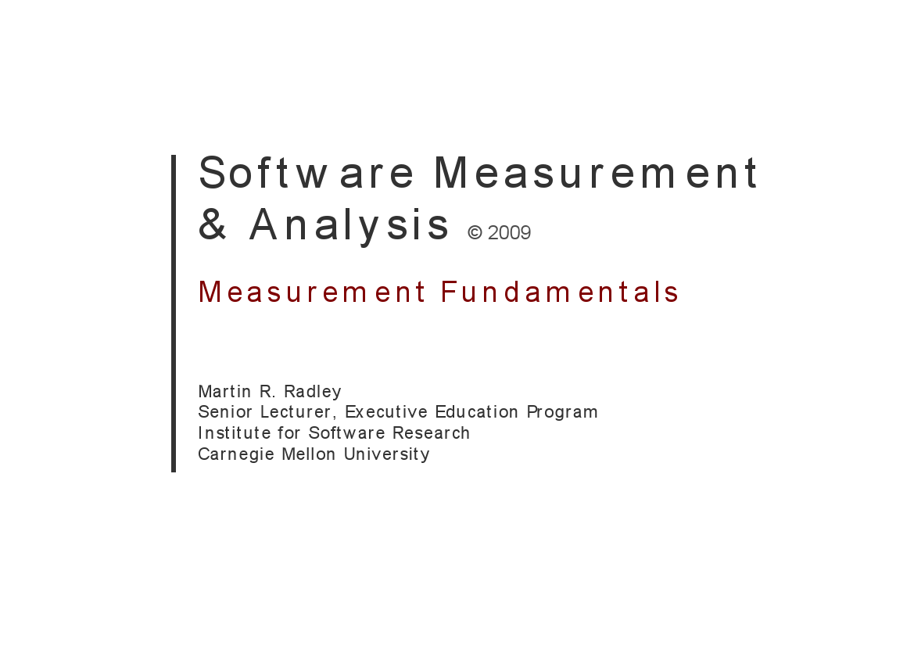

Slide 2






Meet the team
BigFive
®
K16T1

Slide 3
Agenda:
1. What is Measurement?
2. Direct Measures.
3. Indirect Measures.
4. Subject (Soft) Measures.
5. What is Data?.
6. Data Presentation.

Slide 4
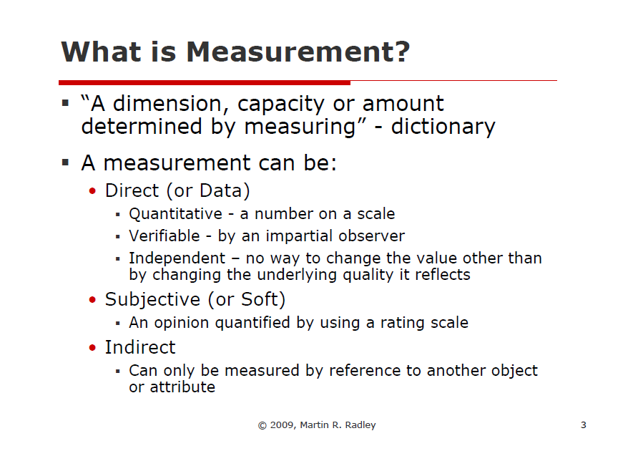
Notes:
Hello
My name
I’m very happy
As you Known
In my presentation

Slide 5
Direct Measures
What is the Direct Measures?
Direct measurement' refers to measuring exactly the thing that you're looking to measure.
Notes:
Hello and welcome to this presentation of team number 5
My name
I’m very happy
As you Known
In think, we are usually use
In my presentation

Slide 6
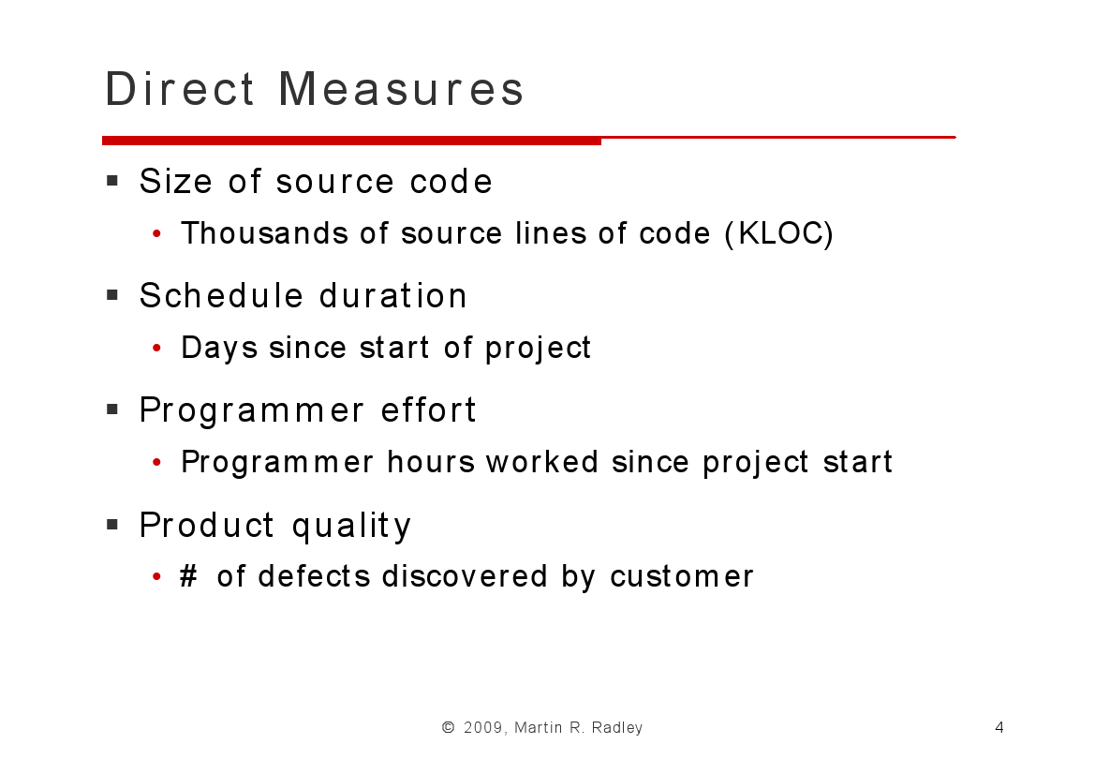
Notes:
Dao

Slide 7
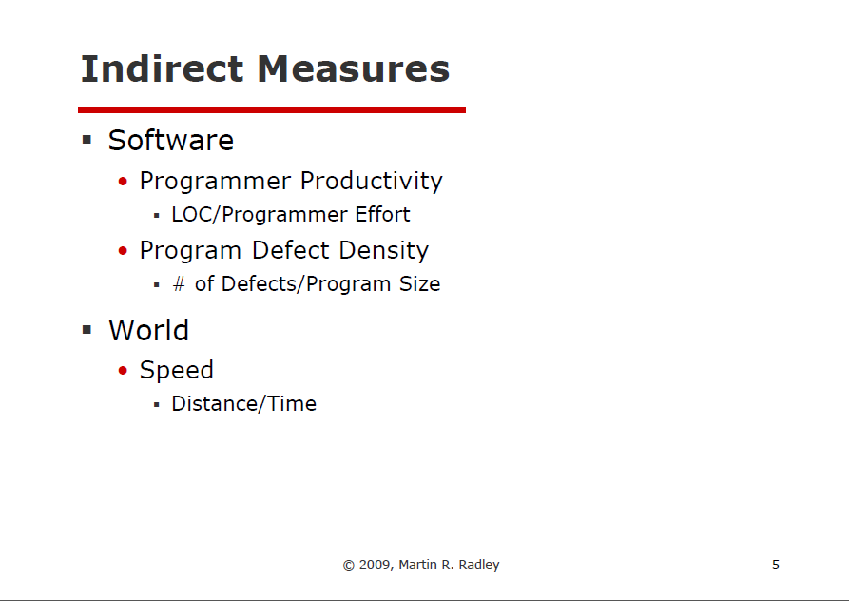
What is indirect measures?
Notes:
Phu

Slide 8
Subjective Measures
Definition: an opinion quantified by using a rating scale
Customer Satisfaction
User Opinion
Notes:
Hello everyone, my name’s Khang. Today i’m very happy when I’m stand here to tell you something about one of three method .. May be last way to measure
Sometimes, you can’t use direct or indirect measure to collect some special data like CS or UO. That’s reason why you need new way, you need other way to measure that
things!! And this method so-called “Subjective measure” follow definition it’s an opinion…

Slide 9
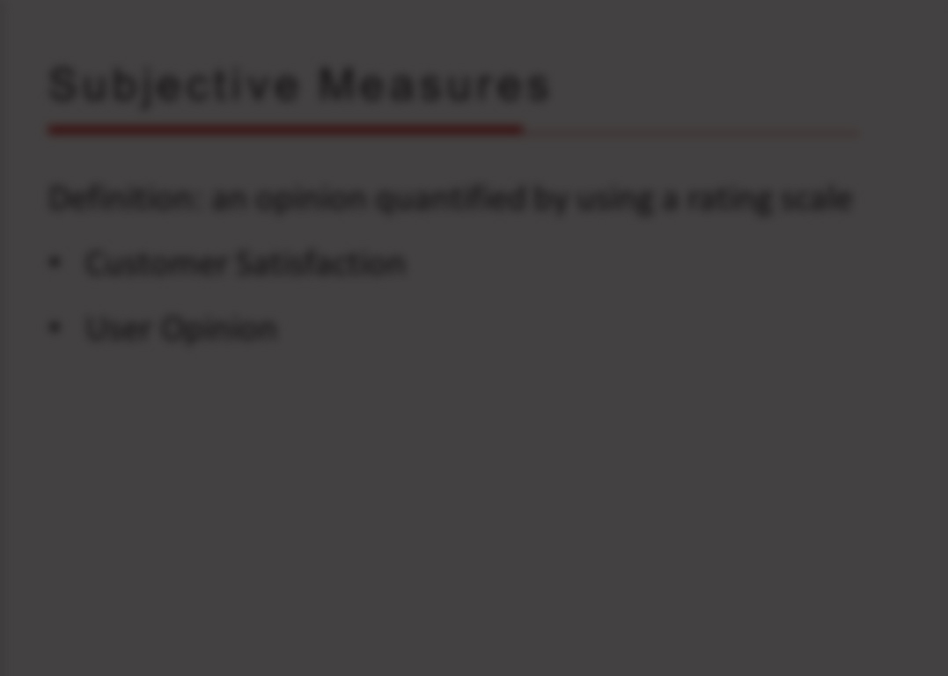

Why we should measure user opinion and customer satisfaction?
Notes:
So, why..
A lot of reason..
Some obvious …
You can assess, you can review your current and improve your process
To increase profits, increase business value. Of course, if you increase your customer satisfaction frist!!!!
When you measure that 2 things, you should apply some tools, into this method to increase effective to measure… survey, liker scale.
With 5 level, you can get some information from customer mind to improve your current.

Slide 10
Subjective Measures
Definition: an opinion quantified by using a rating scale
Customer Satisfaction
User Opinion
→ Measure customer satisfaction or user opinion at key point during the project, not just at the end!
Notes:
Finally, you must remember that…

Slide 11
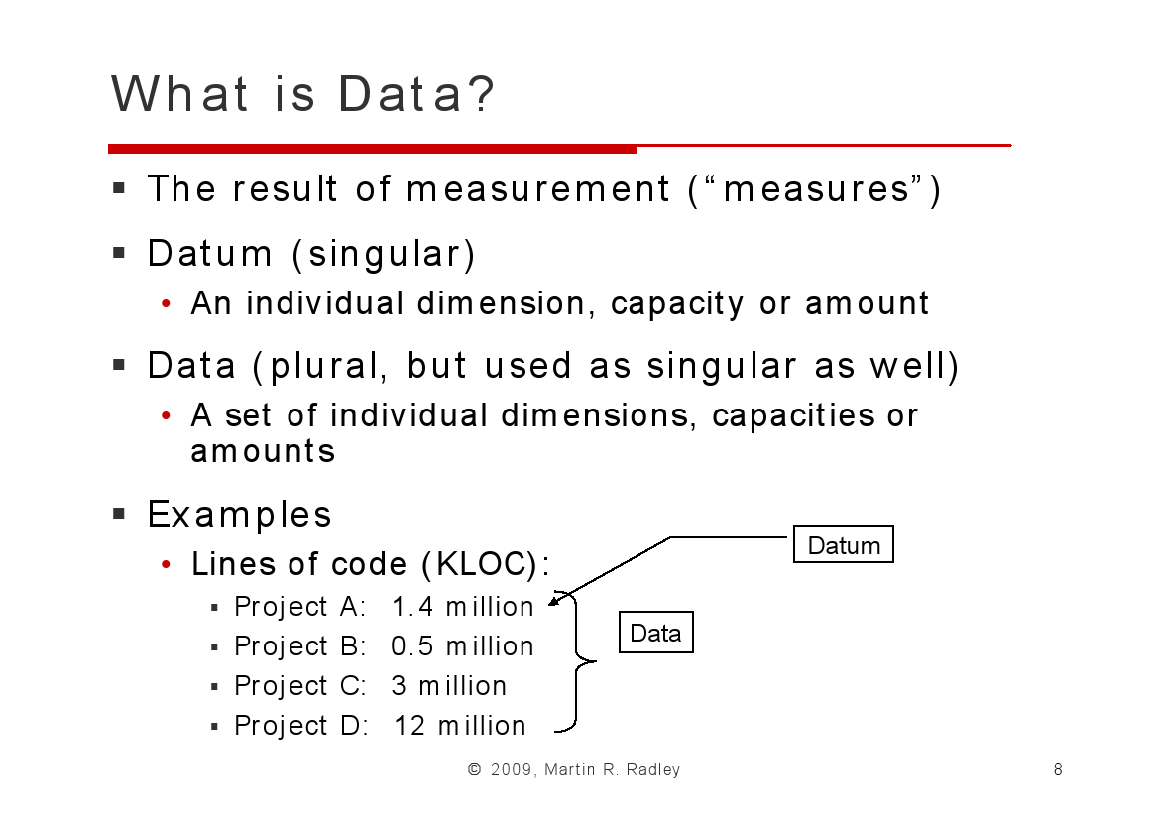



Notes:
Chau

Slide 12
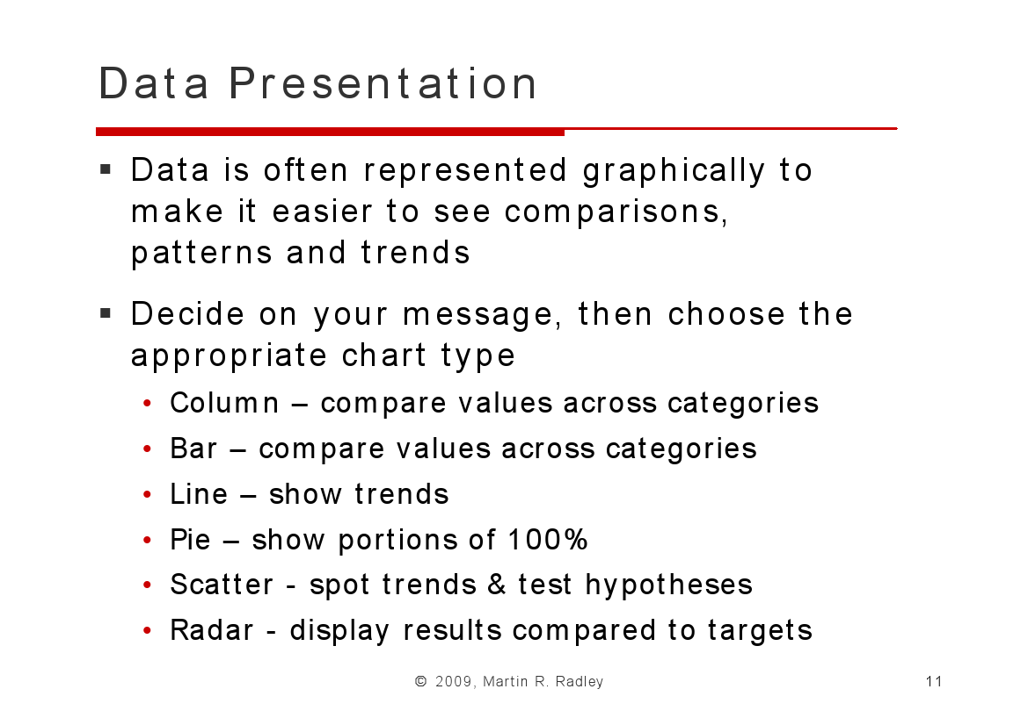
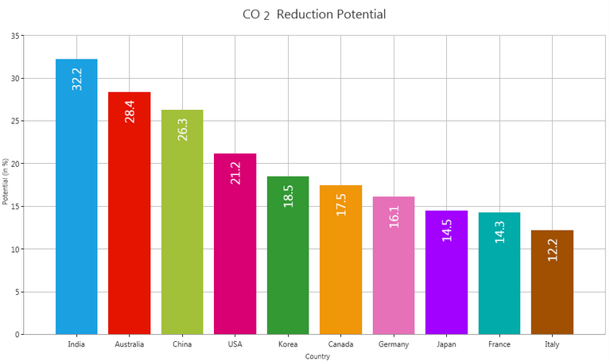
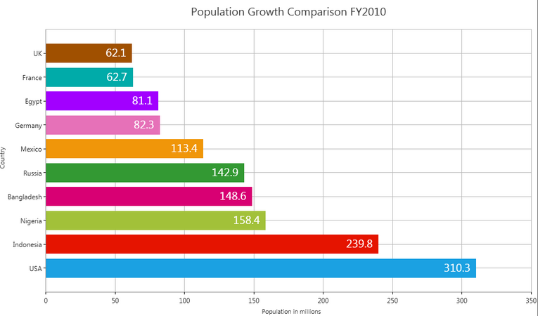
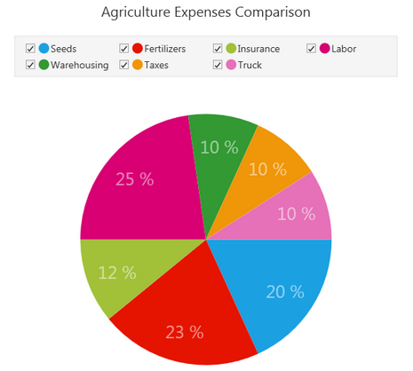

Slide 13

Thanks for your attention!

